Slide 1

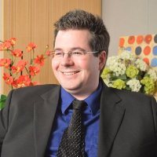
App design
Creating a Top 5 Health/Fitness app using PhoneGap Build
Matt Netkow
Developer/Founder, Netkosoft
www.netkow.com
@dotNetkow
matt.netkow@gmail.com

Slide 2
About me
Senior Developer for The SAVO Group – 5 years
Backend development: automation, tools
Mobile app development side projects
Switched to front-end dev

Slide 3
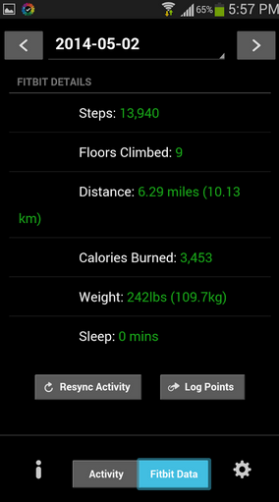
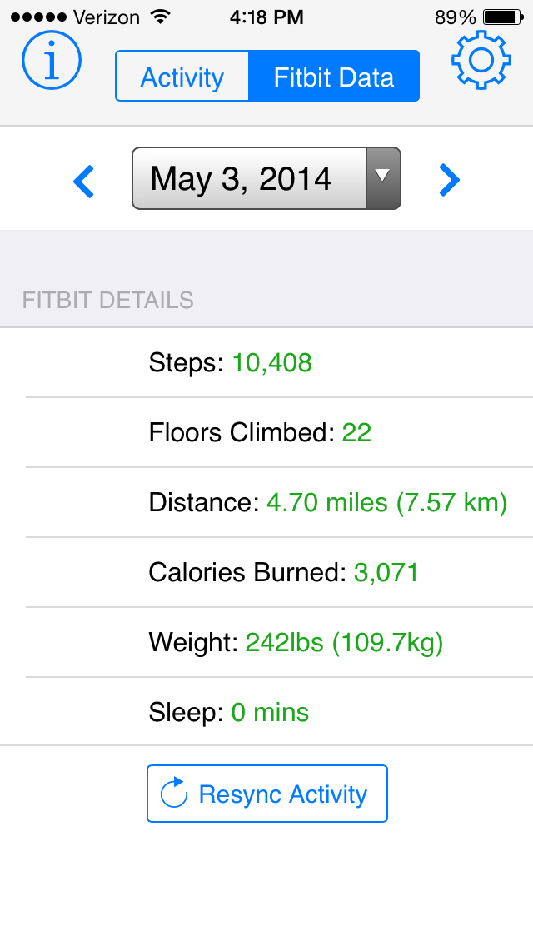
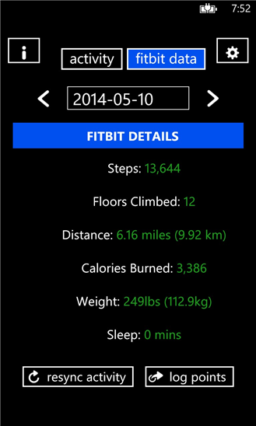
Versions
Android iPhone Windows Phone

